Slide 1
Fourier and Z-transforms
Fourier Transform

Slide 2
Fourier Transform

Slide 3
Introduction

Slide 4

Some important result
$B\left(m,n\right)=\frac{\left\lceil m\right.\left\lceil n\right.}{\left\lceil m+n\right.}$
$\left\lceil n+1=n\left\lceil n\right. \right.$, $\left\lceil n+1=n!\right.$ if n is positive integer, $\left\lceil 1/2\right.=\sqrt{π}$
Rule of differentiation under the integral sign(DUIS):
If $I=\left(α\right)=\int_{a}^{b}{f\left(x,α\right)dx}$, where a and b are constants, then
$\frac{dI(α)}{dα}=\frac{d}{dα}\int_{a}^{b}{f\left(x,α\right)dx}=\int_{a}^{b}{\frac{∂}{∂α}f\left(x,α\right)dx}$

Slide 5

To be continue
4)$e^{ix}=cosx+isinx$ and $e^{−ix}=cosx−isinx$
5)$\left|x\right|≤a⇒−a≤x≤a$ and $\left|x\right|≥a⇒$
$$x≥a and x≤−a$$
6) $\int{e^{ax}sinbx dx=\frac{e^{ax}}{a^{2}+b^{2}}(asinbx−bcosbx)}$
$$\int{e^{ax}cosbx dx=\frac{e^{ax}}{a^{2}+b^{2}}(acosbx+bsinbx)}$$
7)$\int_{0}^{∞}{\frac{sinax}{x}dx=\left\{\begin{matrix}\frac{π}{2} if a is positive \\ −\frac{π}{2} if a is negative\end{matrix}\right.}$

Slide 6

Example
Find the Fourier transform of a function
$f\left(x\right)=e^{−\left|x\right|}$.
Solution: Fourier transform of $f\left(x\right)=e^{−\left|x\right|}$ in the interval $−∞<x<∞$ is given by
$$F\left(λ\right)=\int_{−∞}^{∞}{f\left(u\right)e^{−iλu}du}=\int_{−∞}^{∞}{e^{−\left|u\right|}e^{−iλu}du}$$
$$=\int_{−∞}^{∞}{e^{−\left|u\right|}(cosλu−isinλu)du}$$
$$=\int_{−∞}^{∞}{e^{−\left|u\right|}cosλudu}−i\int_{−∞}^{∞}{e^{−\left|u\right|}sinλudu}$$
Since the integrand in the second integral is odd and hence integral is zero.
$∴F\left(λ\right)=2\int_{0}^{∞}{e^{−u}cosλu du=2\left[\frac{e^{−u}}{1+λ^{2}}(−cosλu+λsinλu)\right]{∞ \atop 0}}$
…$\int{e^{ax}cosbx dx=\frac{e^{ax}}{a^{2}+b^{2}}(acosbx+bsinbx)}$
$$=\frac{2}{1+λ^{2}}$$

Slide 7

Example:
Find the Fourier cosine integral representation for the function $f\left(x\right)=\left\{\begin{aligned}{ x}^{2} , 0<x<a \\ 0, x>a\end{aligned}\right.$
Solution : By using Fourier cosine transform of f(x) is given by
$F_{c}\left(λ\right)=\int_{0}^{∞}{f\left(u\right)cosλu du=\int_{0}^{a}{u^{2}cosλu du}} =\left[u^{2}\left(\frac{sinλu}{λ}\right)−\left(2u\right)\left(−\frac{cosλu}{λ^{2}}\right)+2\left(−\frac{sinλu}{λ^{3}}\right)\right]{a \atop 0}$(using generalised rule of integration by parts)
$$=\frac{a^{2}sinλa}{λ}+\frac{2acosλa}{λ^{2}}−2\frac{sinλa}{λ^{3}}$$
$f\left(x\right)=\frac{2}{π}\int_{0}^{∞}{F_{c}\left(λ\right)cosλx dλ}=\frac{2}{π}\int_{0}^{∞}{\left[\frac{a^{2}sinλa}{λ}+\frac{2acosλa}{λ^{2}}−2\frac{sinλa}{λ^{3}}\right]cosλx dλ}$.

Slide 8

Example
Find the Fourier sine transform of $\frac{1}{x}.$
Solution : By using Fourier sine transform of f(x) is given by
$$F_{s}\left(λ\right)=\int_{0}^{∞}{f\left(u\right)sinλu du=\int_{0}^{∞}{\frac{1}{u}sinλu du}}$$
Putting $λu=t and du=\frac{dt}{λ}$
$$=\int_{0}^{∞}{\frac{λ}{t}sint\frac{dt}{λ}=\int_{0}^{∞}{\frac{sint}{t}dt=\frac{π}{2}.}}$$

Slide 9
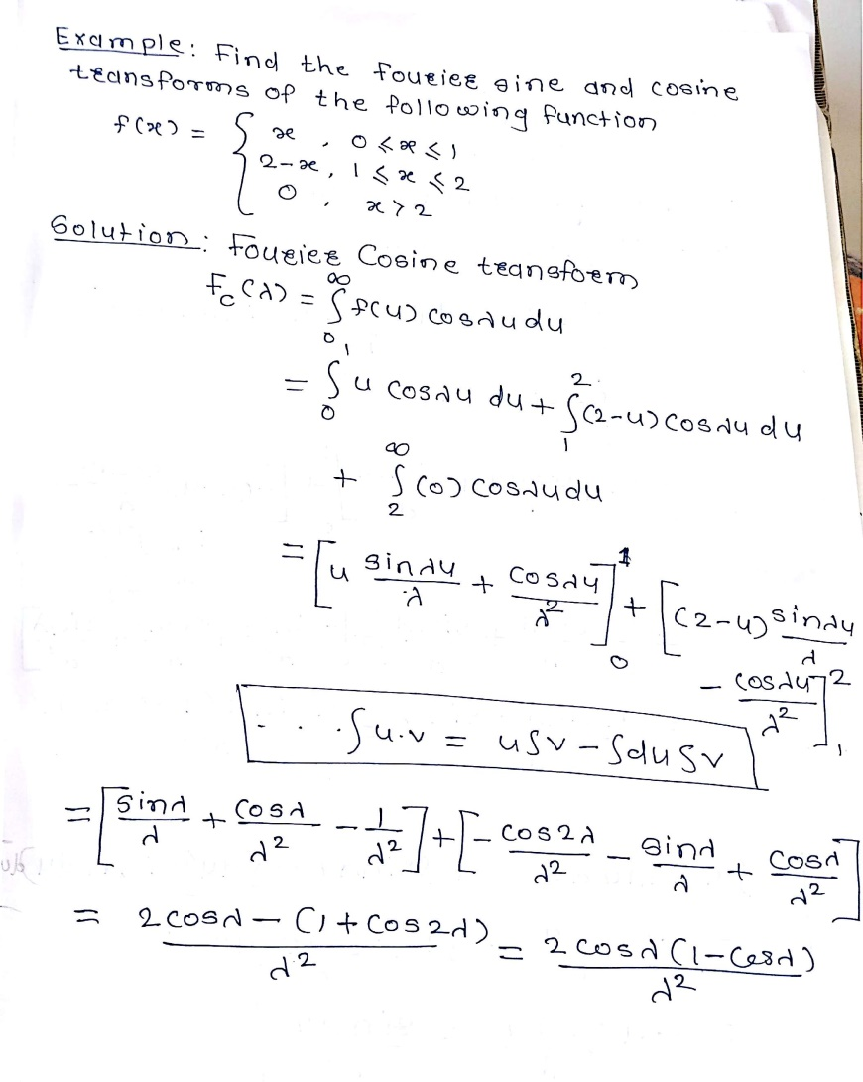

Slide 10
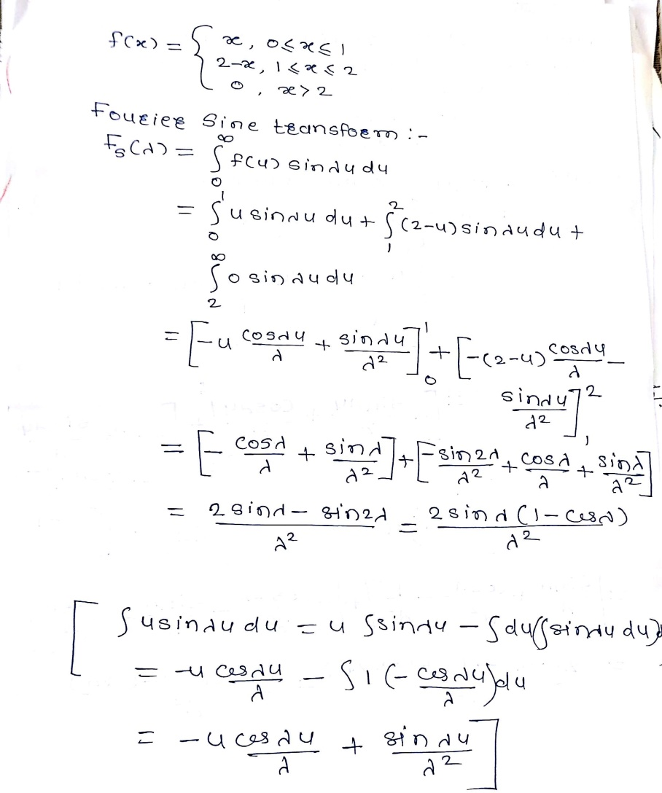

Slide 11
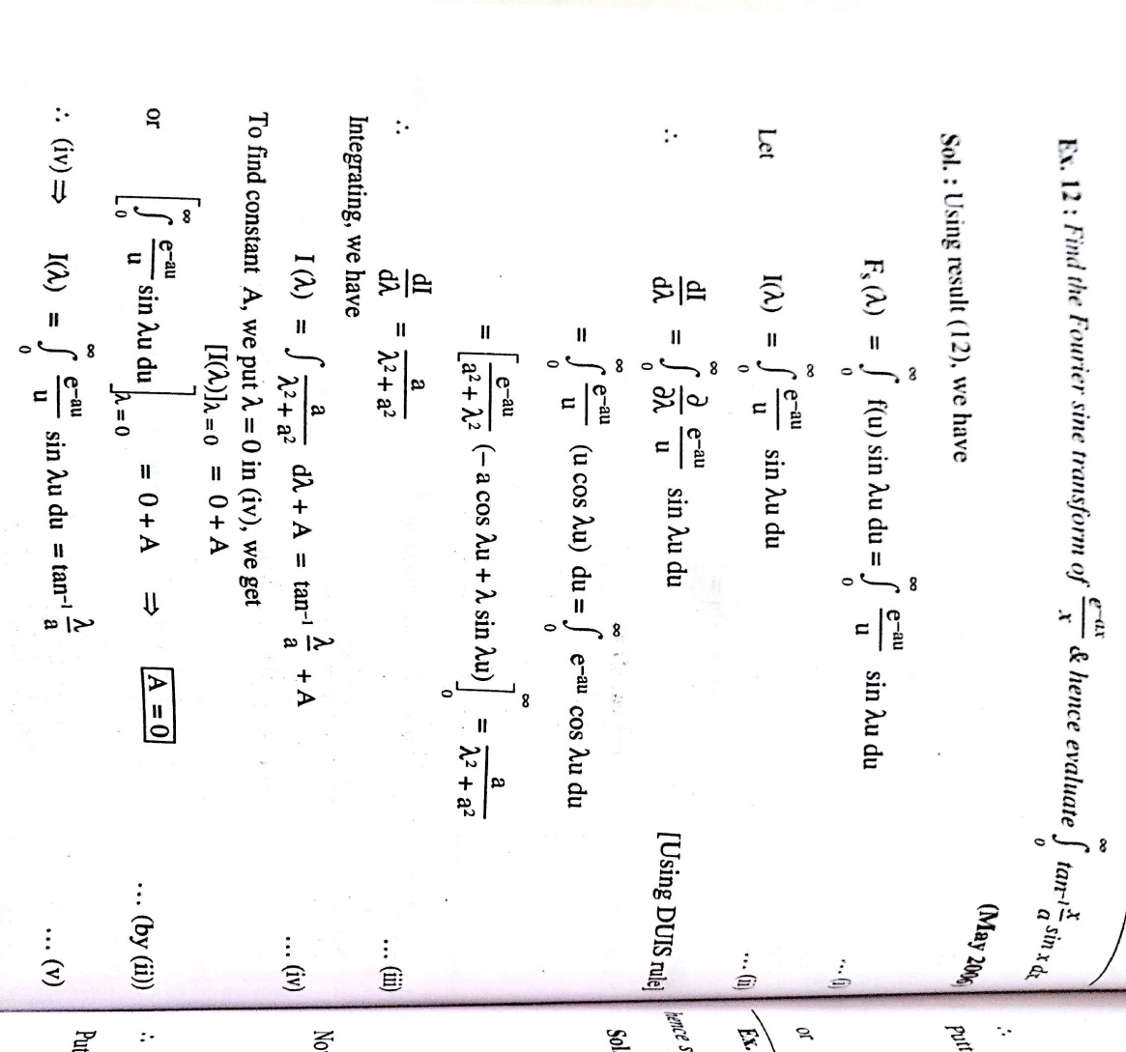

Slide 12
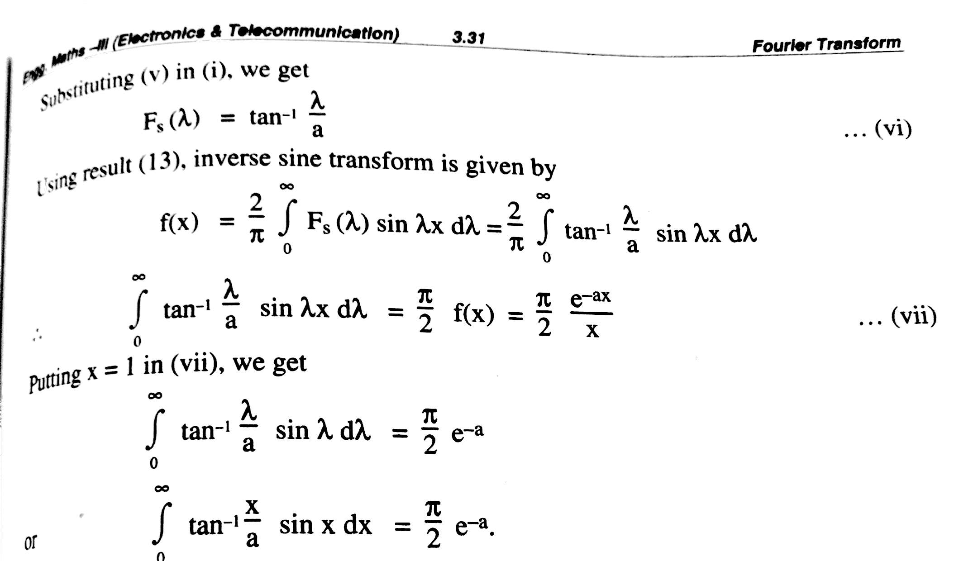

Slide 13

Inverse Fourier transform
Solve the following integral equations:
$$\int_{0}^{∞}{f\left(x\right)sinλx dx=\left\{\begin{aligned}1−λ, 0≤λ≤1 \\ 0,λ≥1\end{aligned}\right.}$$
Solution : since the term $sinλx$ is present in the integral, using the Fourier sine transform of f(x) is given by $F_{s}(λ)=\int_{0}^{∞}{f\left(x\right)sinλx dx=\left\{\begin{aligned}1−λ, 0≤λ≤1 \\ 0,λ≥1\end{aligned}\right.}$
To find f(x), we obtain inverse Fourier sine transform thus $f\left(x\right)=\frac{2}{π}\int_{0}^{∞}{F_{s}\left(λ\right)sinλx dλ=}\frac{2}{π}\int_{0}^{1}{(1−λ)sinλx dλ}$
$$=\frac{2}{π}\left[\left(1−λ\right)\left(−\frac{cosλx}{x}\right)−(−1)\left(−\frac{sinλx}{x^{2}}\right)\right]{1 \atop 0}$$
$$=\frac{2}{π}\left[−\frac{sinx}{x^{2}}+\frac{1}{x}\right]$$

Slide 14
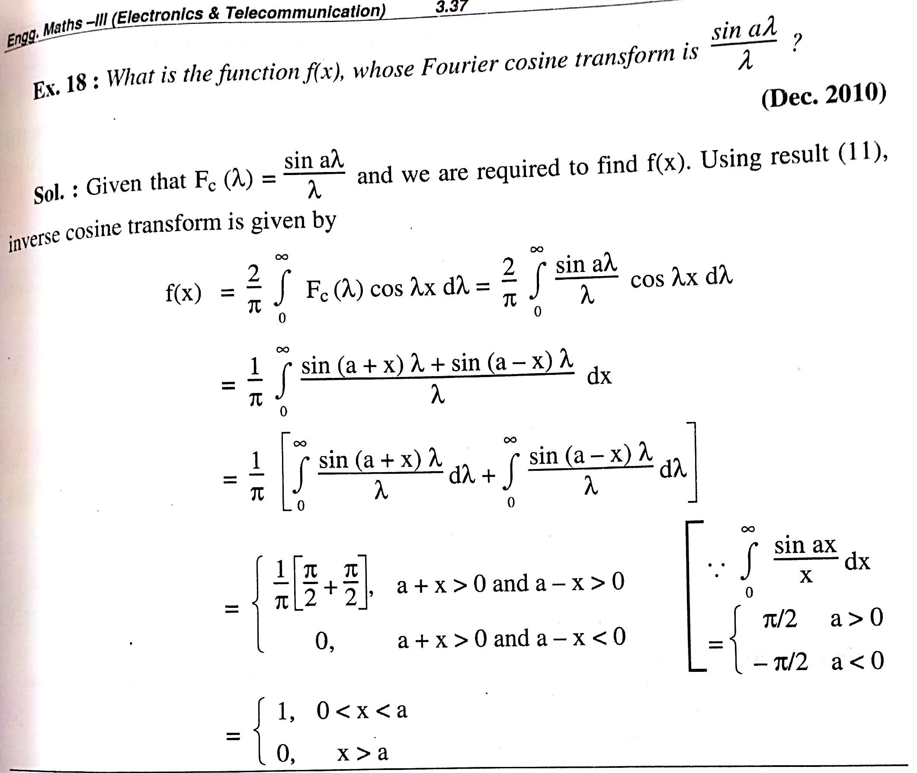

Slide 15
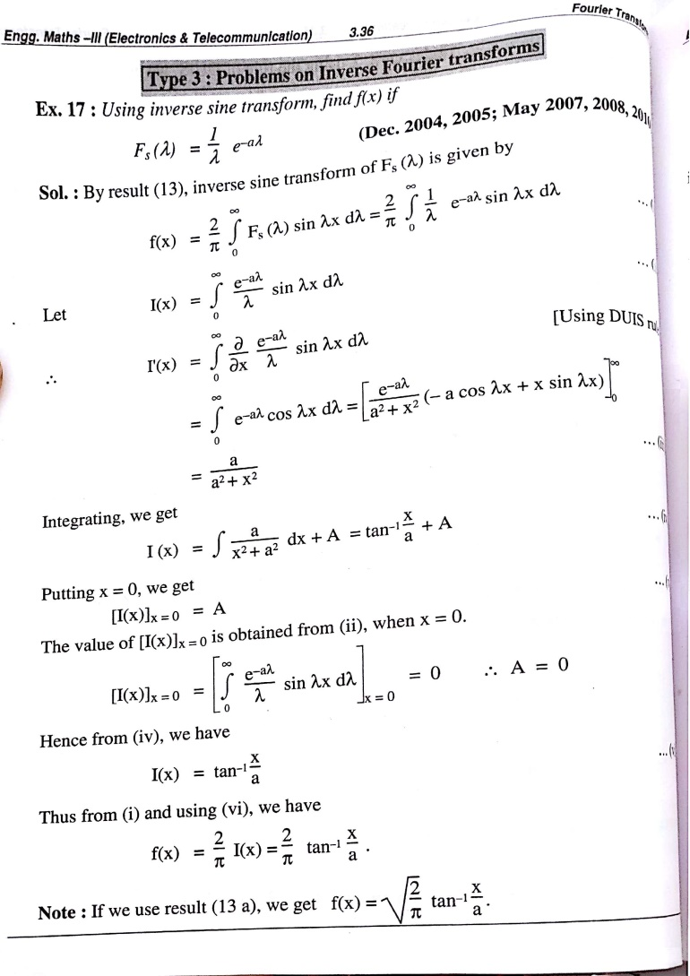

Slide 16
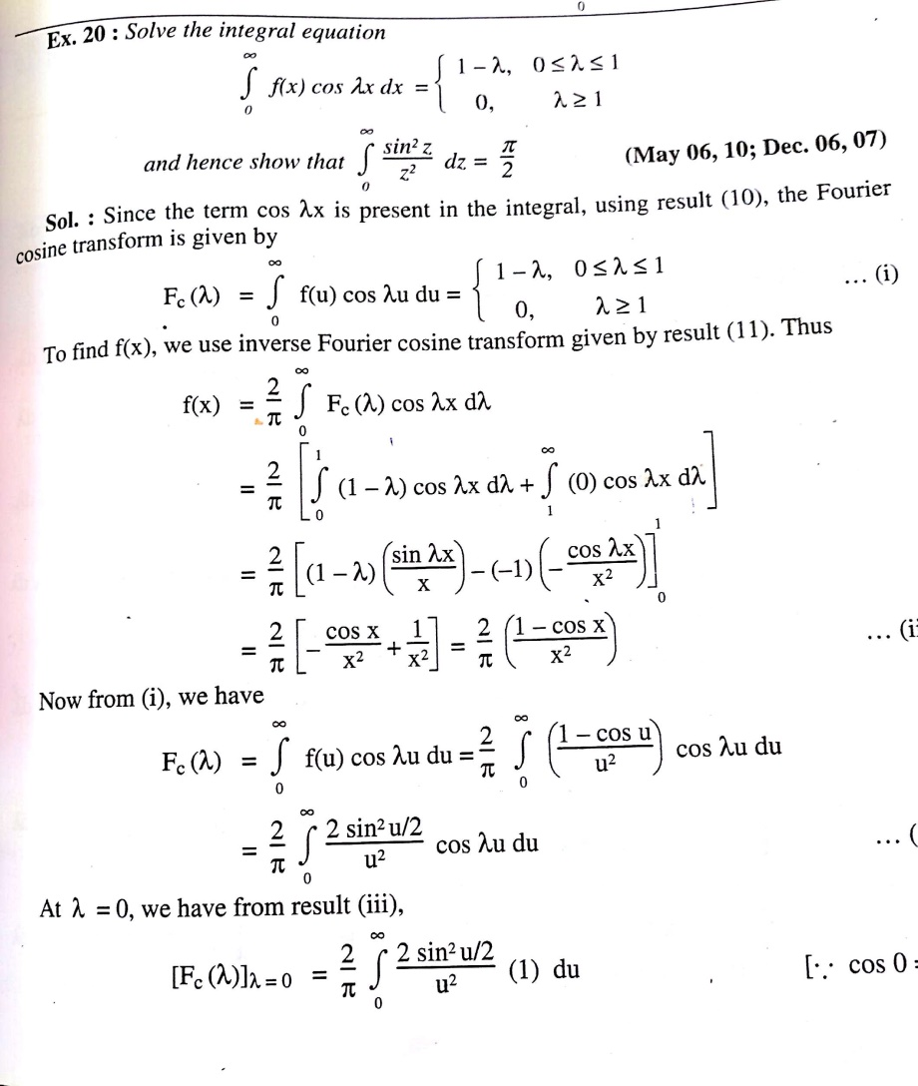

Slide 17
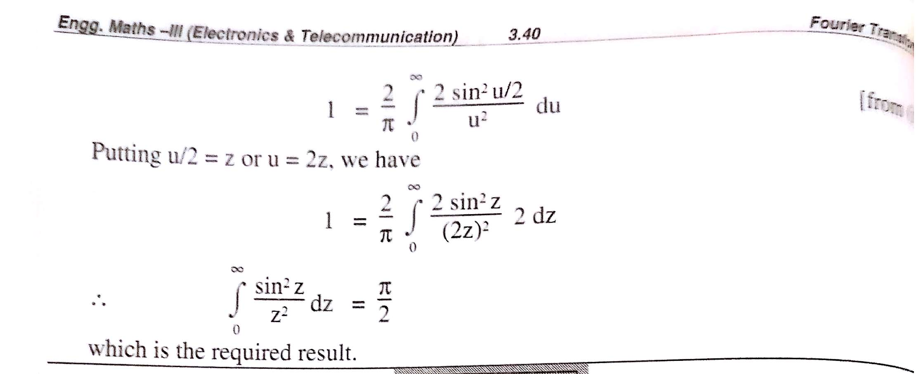

Slide 18

$\int{u.v=u\int{v}−\int{du}\int{v}}$
$\int{u^{2}cosγudu=u^{2}\int{cosγu}−\int{du^{2}\int{cosγu}}}$
$\frac{u^{2}sinγu}{γ}−\int{\frac{2usinγu}{γ}}$= $\frac{u^{2}sinγu}{γ}−$2/$γ$(u$\left(−\frac{cosγu}{γ}\right)−\int{1\int{sinγudu}}$

Slide 19
F(X)=F(-X) COSX=COS-X=COSX
F(X)= -F(X) SINX=-SIN-X

